Slide 1
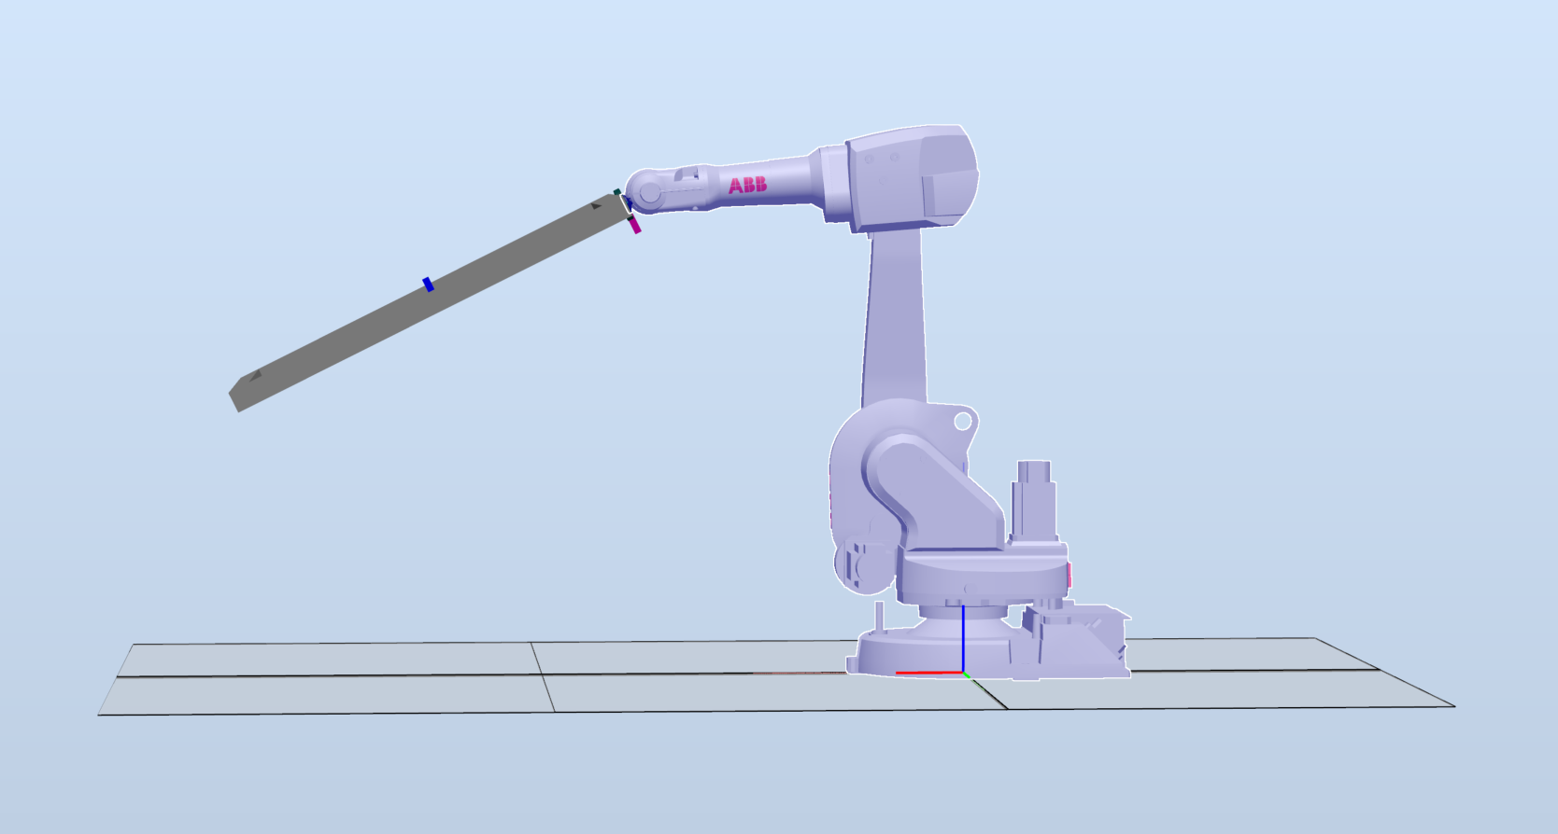
X-Plane
Pitch Angle

Slide 2
Z-axis

Slide 3
Pitch Angle
Vectors normal to surface plane
Z-axis
X-Plane

Slide 4
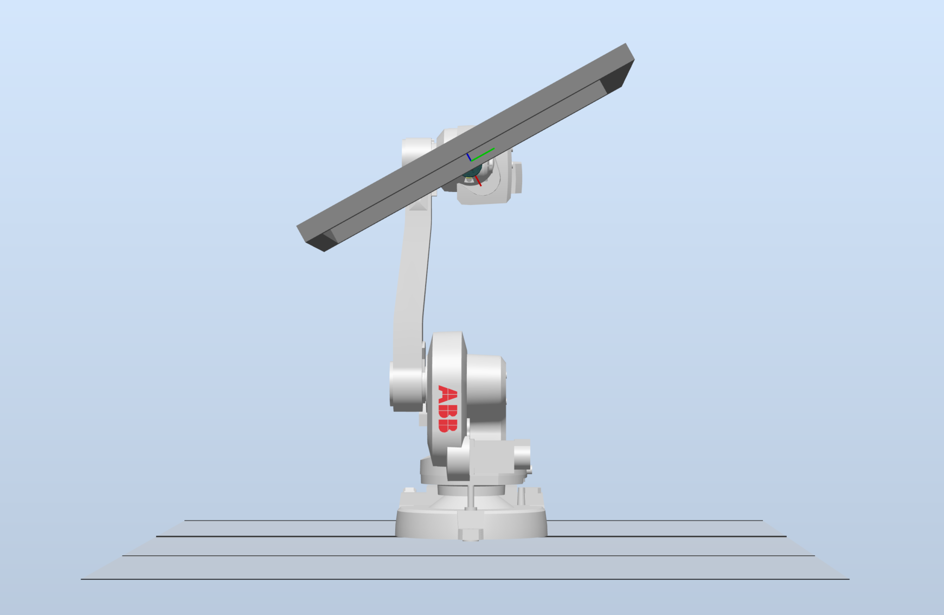
Normal vector of surface
Roll Angle

Slide 5
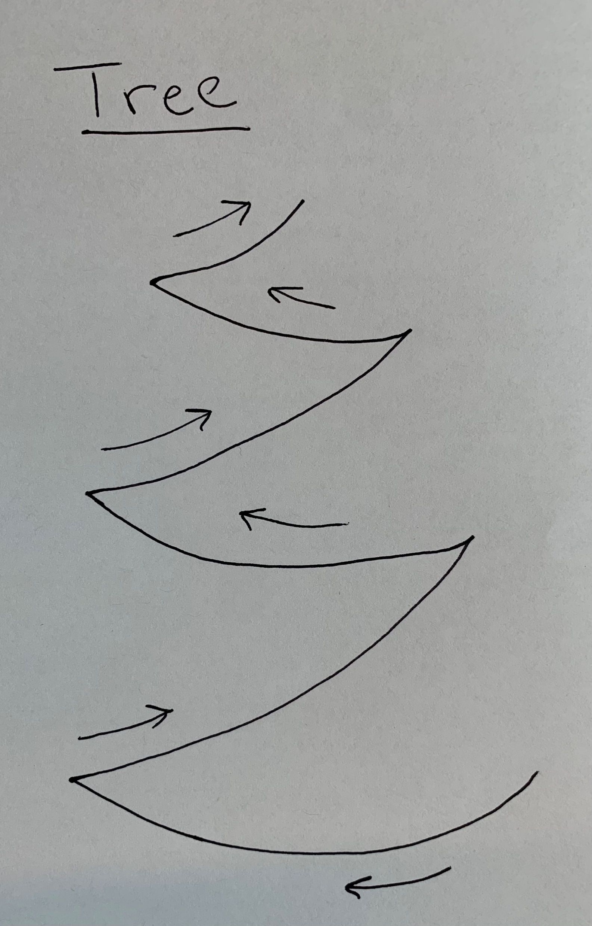
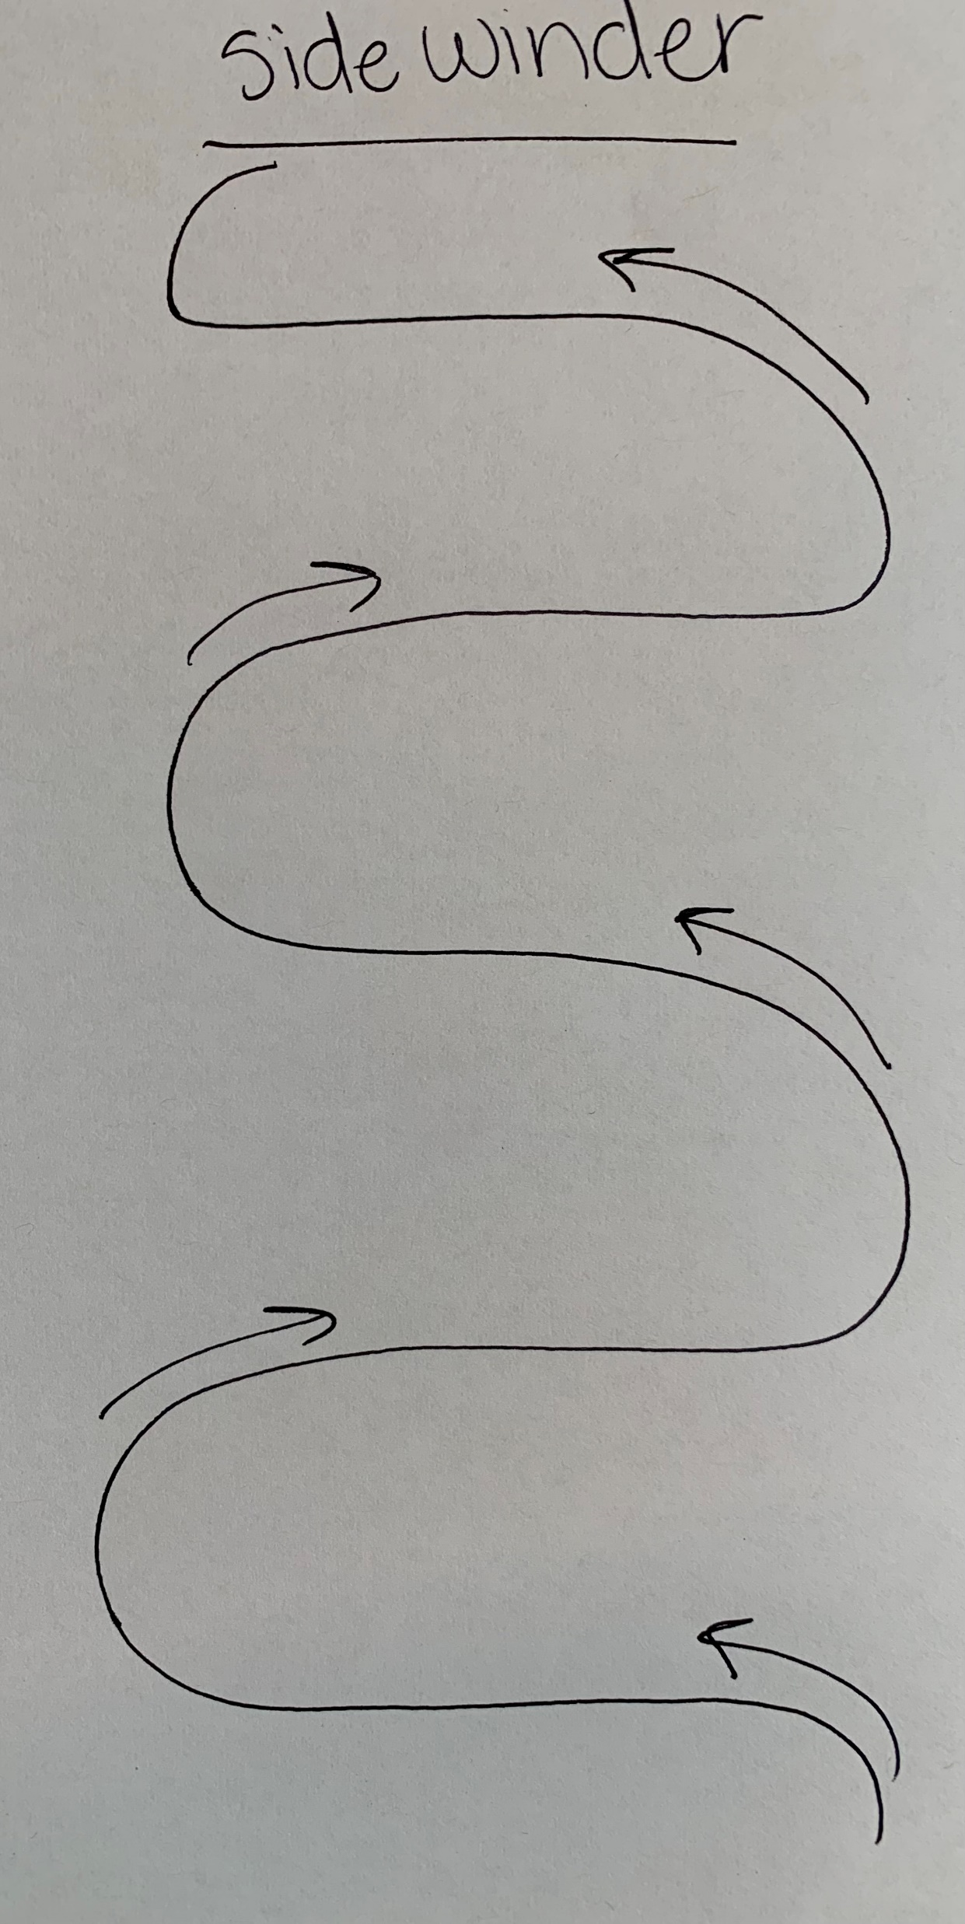
Z-Axis
X-Axis
Y-Axis
Y-Axis

Slide 6
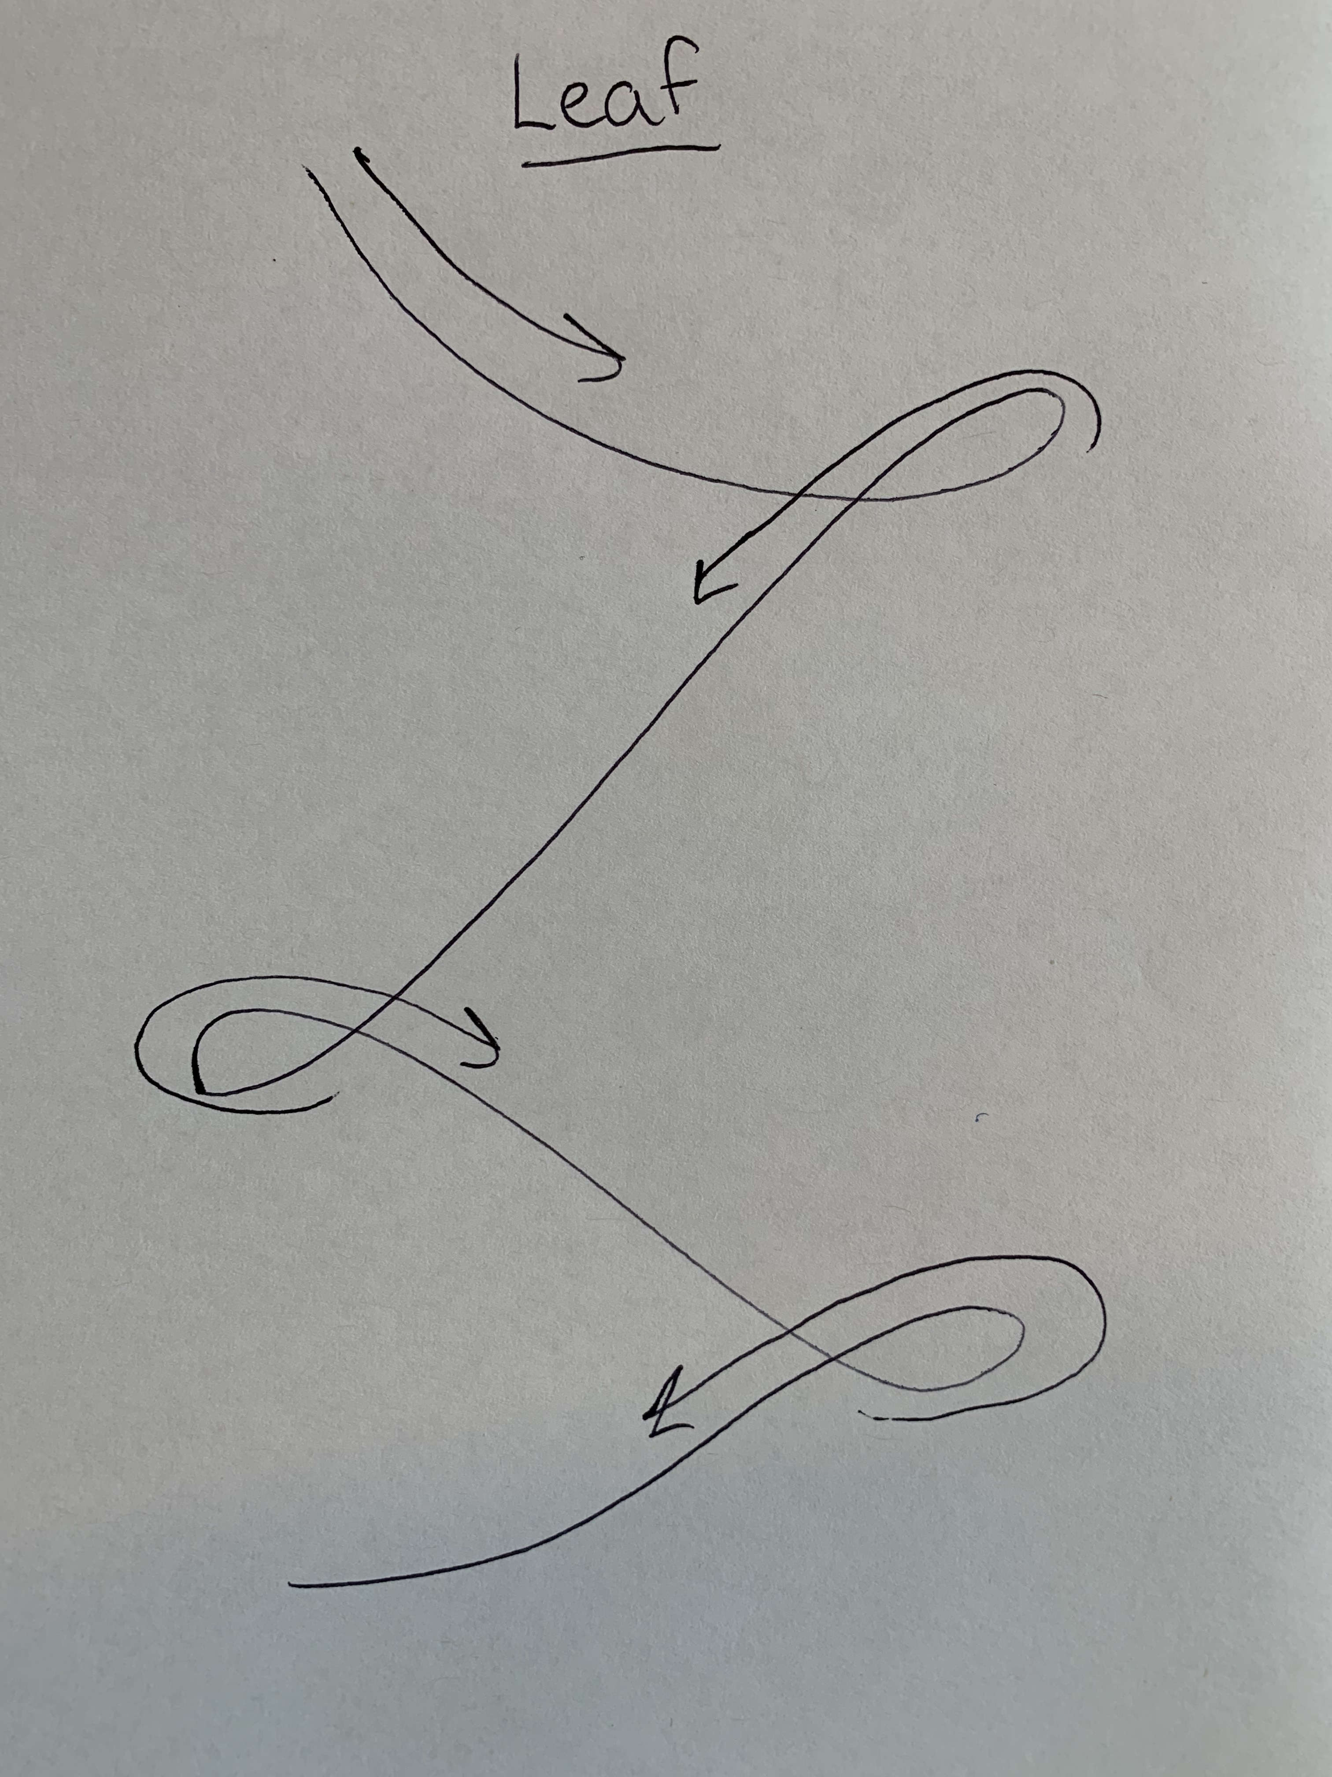
Z-Axis
Y-Axis

Slide 7
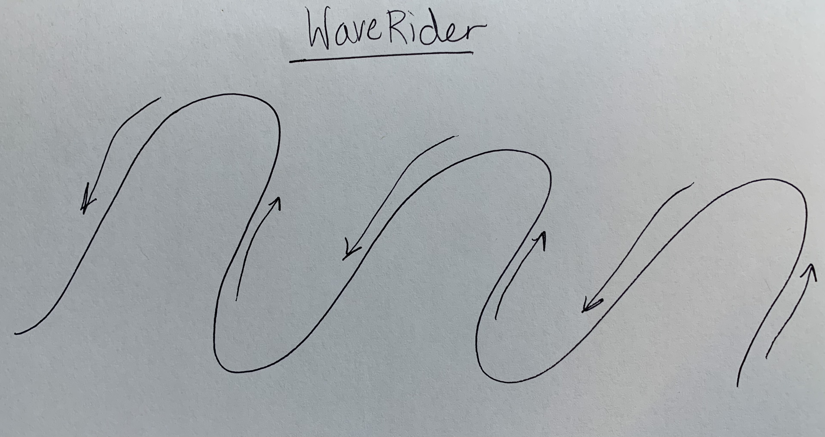
Z-Axis
X-Axis

Slide 8
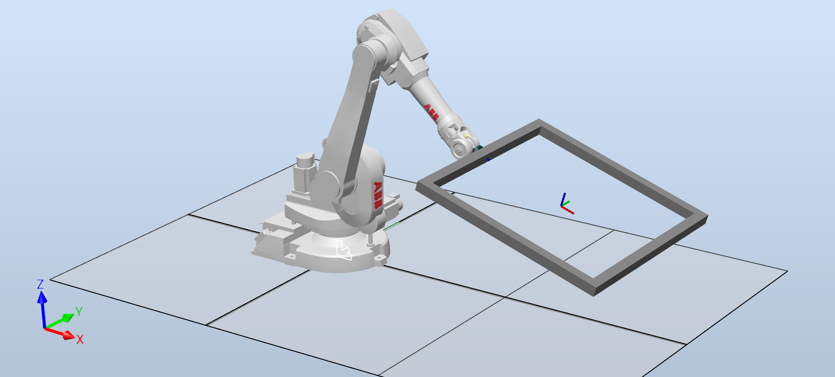
Tool Data: Tooldata_9
Work Object: Workobject_2

